Slide 1
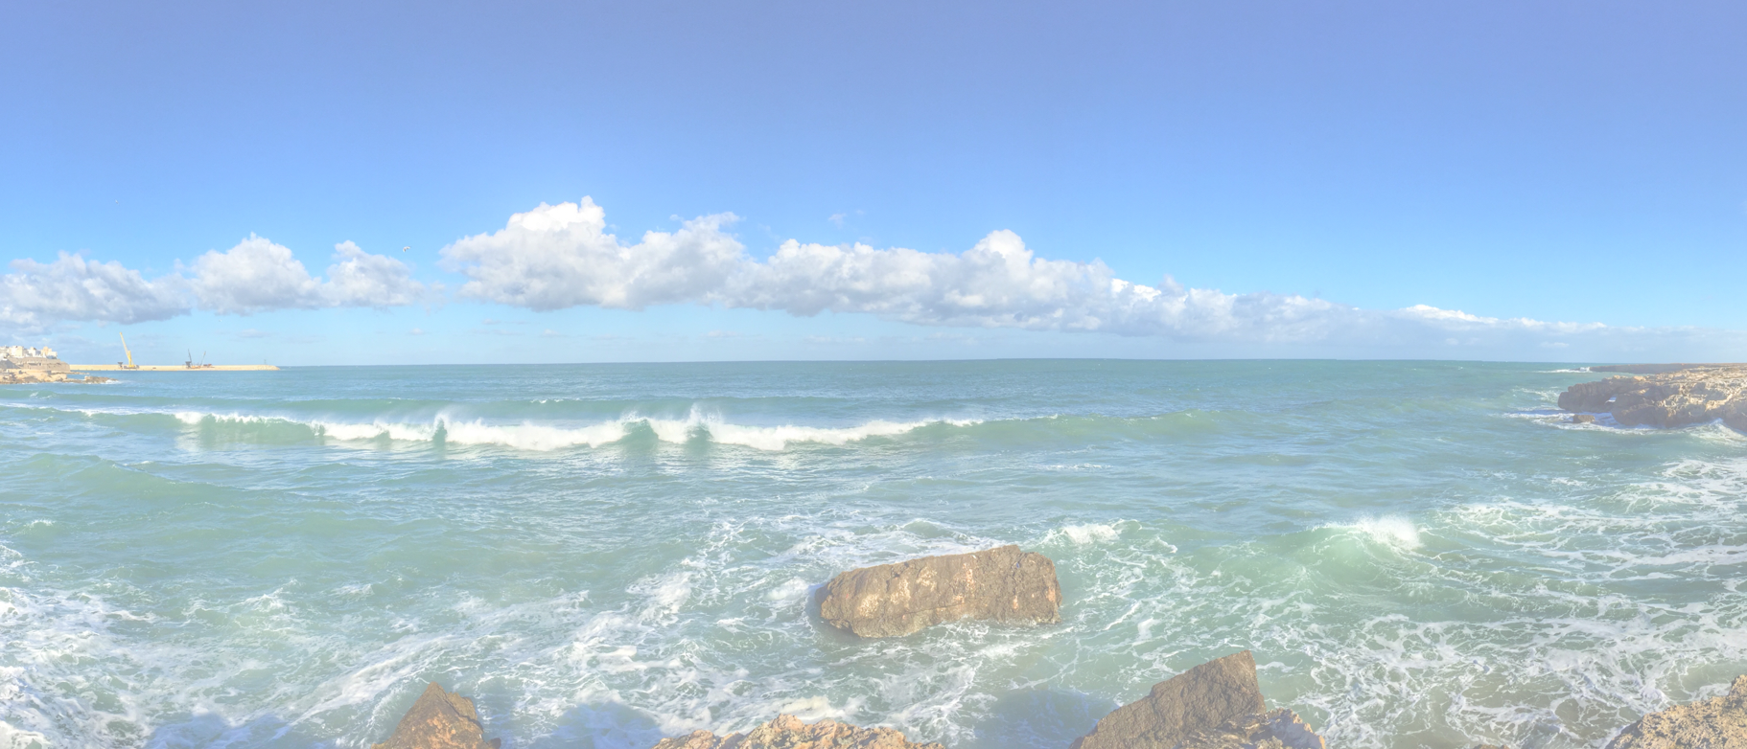
Value Proposition <description>

Slide 2
Value Proposition <description>
For
[customer segment ]
Key learnings:
We assumed that…
Based on … we…
Later we learned that..
Hence we...
Who
[statement of need or opportunity]
Our
[name of product or service]
Is
[product category]
That
[statement of benefit]
4-8-2021
Hans Rood
https://www.redharbour.nl/Value-Proposition-UK/
2
Notes:
describe and update your persona canvas What has changed based on the learnings?

