Slide 1
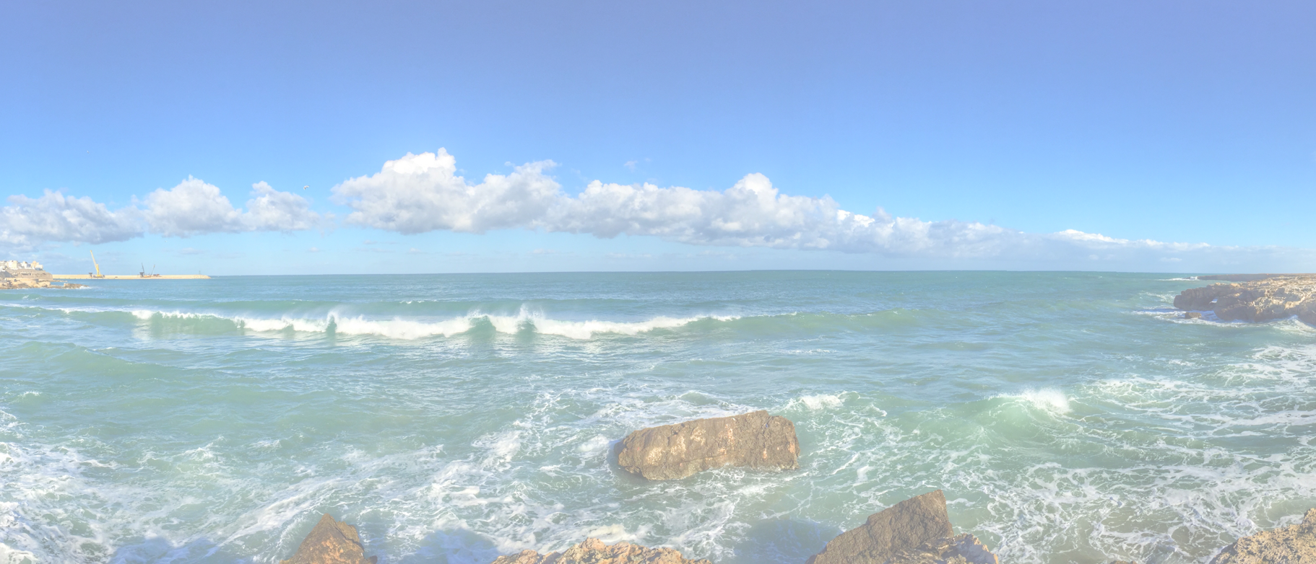
Value Map Canvas <subject>

Slide 2
Value Map Canvas <subject>
Gain Creators
[How does your product/service create customer gains?]
Pain Relievers
[How does your product/service reduce the pain?]
Key learnings:
We assumed that…
Based on … we…
Later we learned that..
Hence we...
Products/Services
[List the products and services your value proposition builds on]
3-8-2021
Hans Rood
2
Notes:
keep in mind:
Is the person you are writing your valueprop for:
- Still unaware of their problem?
- Aware of a problem but unaware of a solution?
- Aware of solutions, but looking for the best one?
- Aware of your great product, but still undecided?

