Slide 1
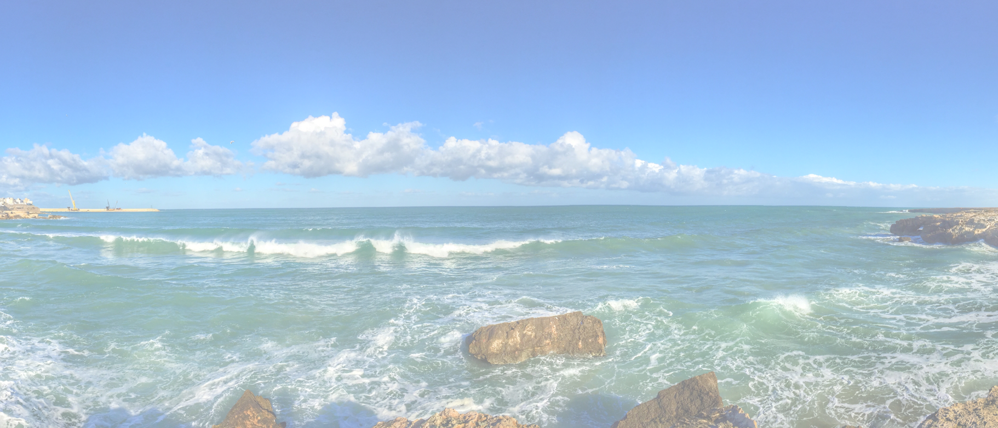
Problem Statement <description>

Slide 2
Problem Statement <decription>
Who
Explain the specific individuals, groups or organizations that the problem affects.]
Key learnings:
We assumed that…
Based on … we…
Later we learned that..
Hence we...
What
[Describe the problem’s boundaries - the problem itself, the effect it has, what would happen if the problem gets solved or what would happen with the customer if you aren’t able to find a solution.]
When
[State when the issue starts and when you need to solve it.]
Where
[State where the problem happens whether it’s just in a specific location or in different areas.]
Why
[Describe the importance of solving the problem and how solving the problem would improve the life of your persona.]
https://www.redharbour.nl/Problem-Statement-UK/
4-8-2021
Hans Rood
2
Notes:
describe and update your persona canvas What has changed based on the learnings?

