Slide 1
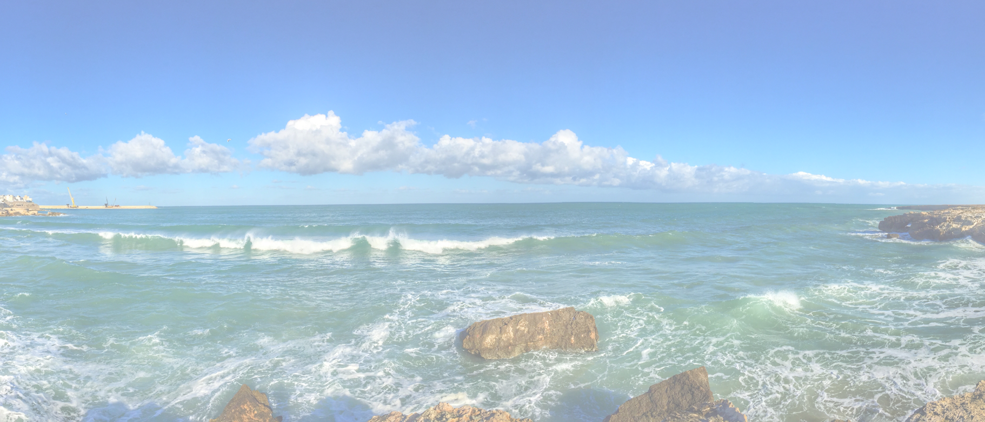
Persona <description>

Slide 2
Persona <description>
Demographics
Personality
Motivations
Preferred Channel
Interest
Goals
Pains
Quote
Key Reason to Buy
Deal Maker
Deal Breaker
https://www.redharbour.nl/Personas-UK/

