Slide 1
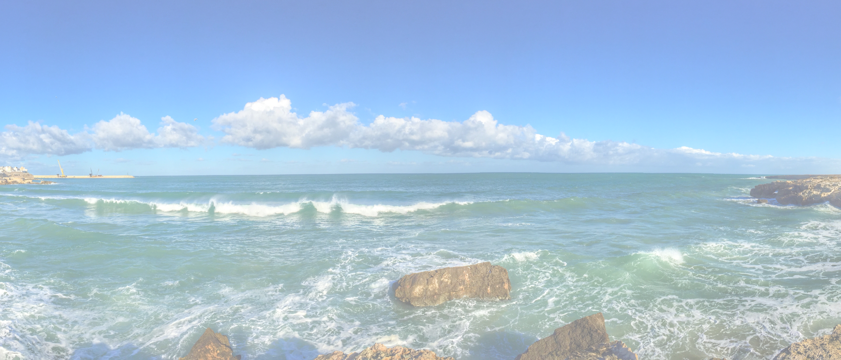
LEAN Canvas <subject>

Slide 2
LEAN Canvas
Problem
[List your top 3 problems]
Solution
[Outline a solutions for each problem]
Unique Value Proposition
[Single, clear, compelling message that turns an unaware visitor in an interested prospect]
Unfair Advantage
[Something that can’t be copied or bought]
Cost Structure
[List your fixed and variable costs for e.g. running the business, overhead, development, etc.]
Key Metrics
[List the key numbers that tell you how you are doing]
Channels
[How are yout going to reach your customers]
Customer Segments
[List your target customers]
Revenue Streams
[List your sources of revenu]
3-8-2021
Hans Rood
2

