Slide 1
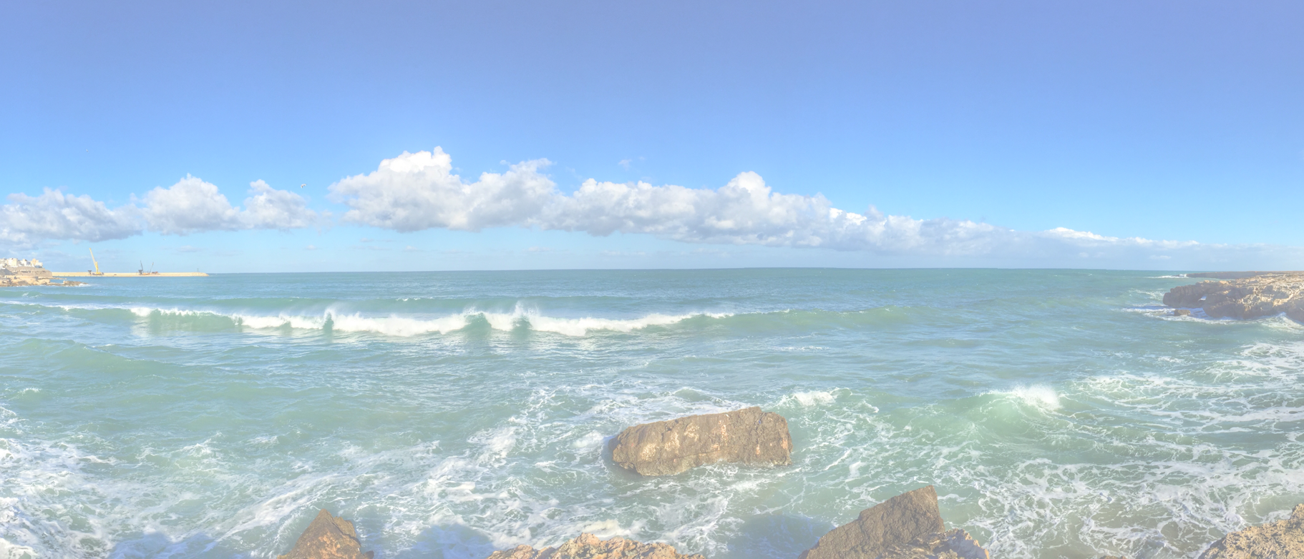
Job to be done <subject>

Slide 2
Job to be done <subject
Current situation - business as usual
Future situation - new behavior
Push
Pull
Habits
Anxiety
https://www.redharbour.nl/Job-to-be-Done-UK/
4-8-2021
Hans Rood
2

