Slide 1
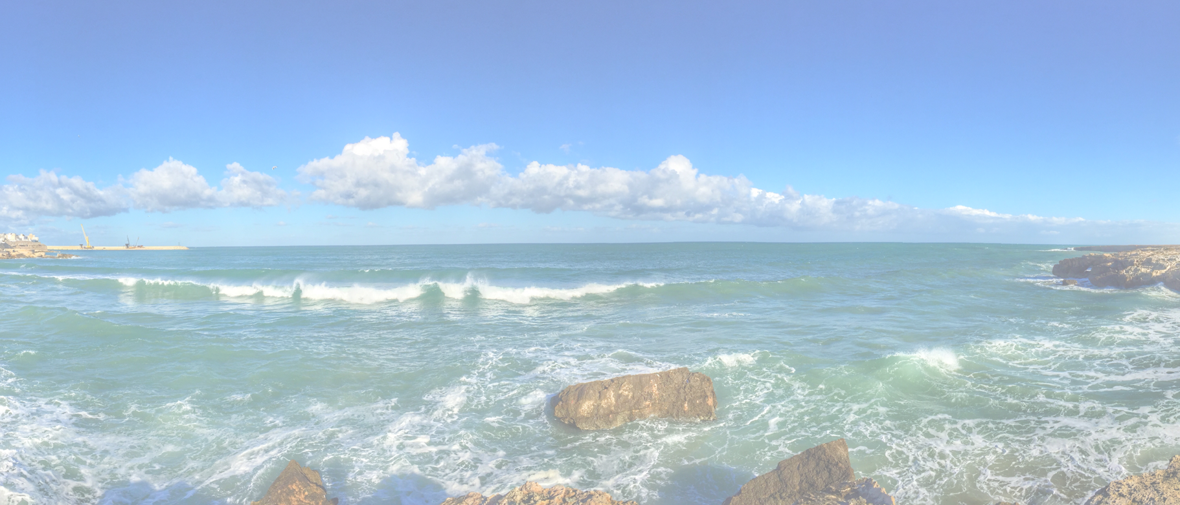
Job Context Canvas <description>

Slide 2
Job Context Canvas
Jobs to be done
[What progress does he/she want to make?]
Key learnings:
We assumed that…
Based on … we…
Later we learned that..
Hence we...
Pains
[Describe the pains that occur while trying to achieve the Jobs to be Done]
Gains
[Which benefits result from achieving the Jobs to be Done?]
4-8-2021
Hans Rood
2

