Slide 1
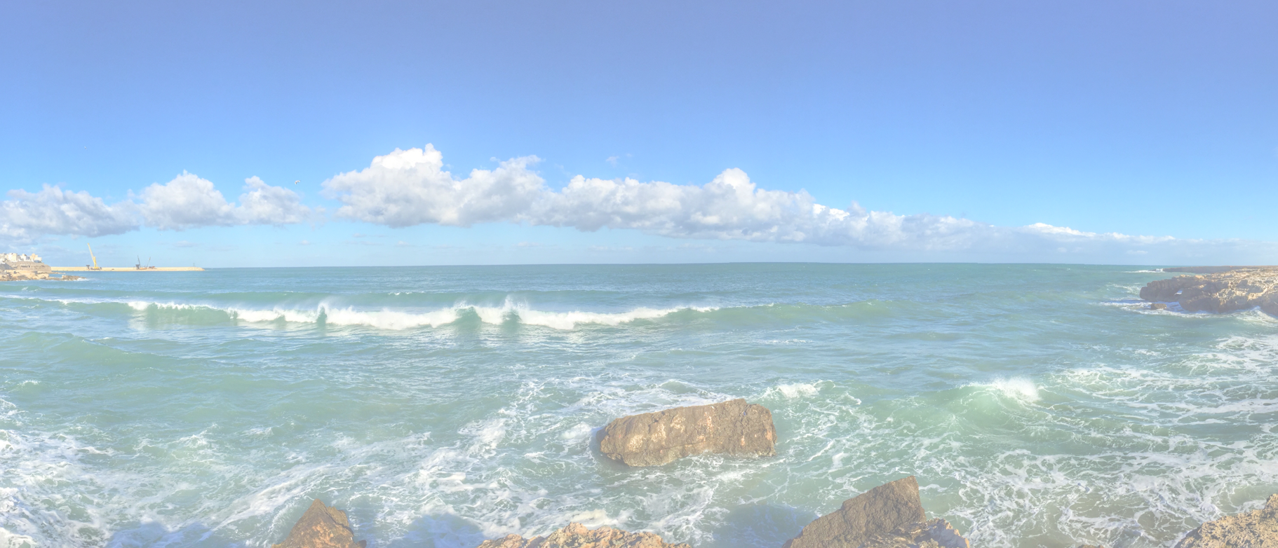
Investor Pitch Canvas <company>

Slide 2
Investor Pitch Canvas (IPC) <company>
Team Qualification
Value Proposition
Track Record
Customer Segments
Market
Unique Sellings Points
Growth Engine
Problem to Solve
Sales Forecast
Product Costs
Product Income
Profit
Requested Investment
4-8-2021
Hans Rood
https://www.redharbour.nl/Investor/
2

