Slide 1
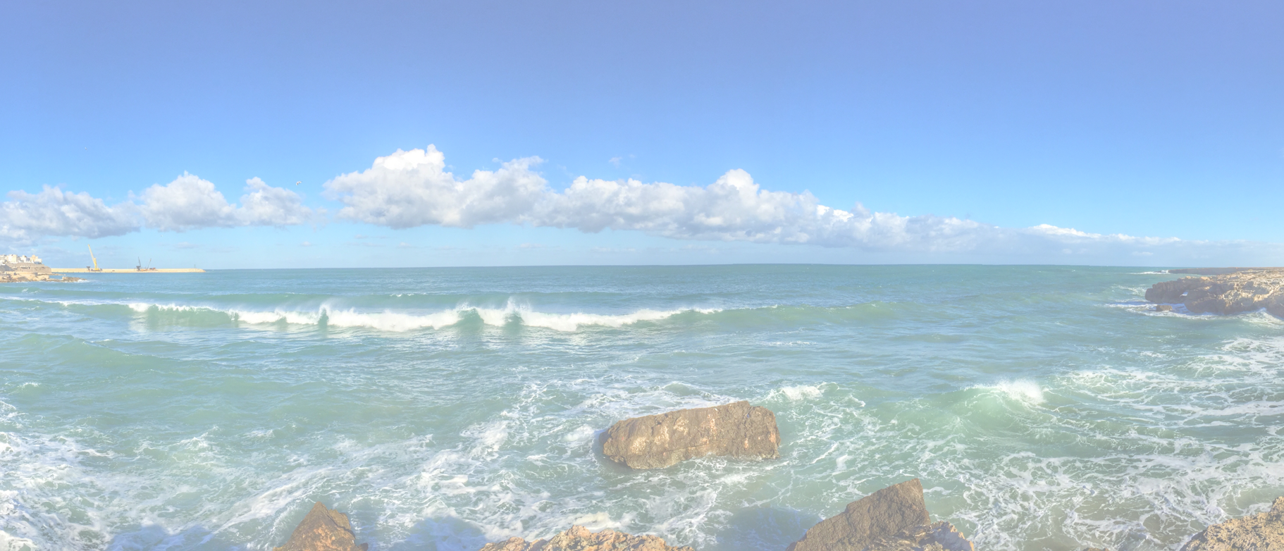
Customer Journey <description>

Slide 2
Customer Journey <description>
Stage
Stage 1
Stage 2
Stage 3
Stage 4
Activity 1
Activity 2
Activity 3
Activity 4
Activity 5
Activity 6
Activity 7
Activity 8
Activity 9
Activity 10
Activities
Positive
Feelings
(Moments
of
Truth)
Negative
Feeling
Opportunities
For
Improvement

