Slide 1
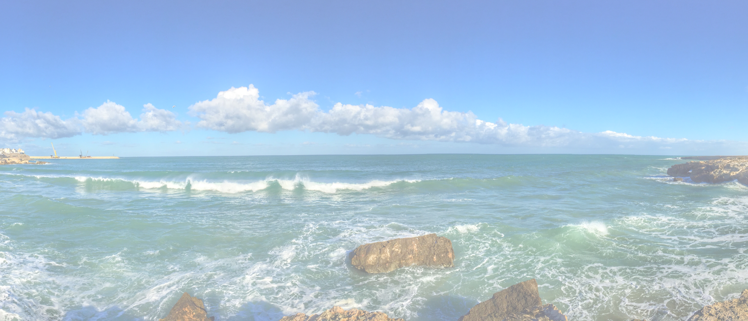
Red Harbour Full Template Set (black and white)

Slide 2
Business Model Canvas (BMC)
Key Partners
Key Activities
Value Proposition
Customer Relationships
Customer Segments
Key Resources
Channels
Cost Structure
Revenue Streams
https://www.redharbour.nl/BMC-UK/

Slide 3
Investor Pitch Canvas (IPC) <company>
Team Qualification
Value Proposition
Track Record
Customer Segments
Market
Unique Sellings Points
Growth Engine
Problem to Solve
Sales Forecast
Product Costs
Product Income
Profit
Requested Investment
4-8-2021
Hans Rood
https://www.redharbour.nl/Investor/
3

Slide 4
Customer Journey <description>
Stage
Stage 1
Stage 2
Stage 3
Stage 4
Activity 1
Activity 2
Activity 3
Activity 4
Activity 5
Activity 6
Activity 7
Activity 8
Activity 9
Activity 10
Activities
Positive
Feelings
(Moments
of
Truth)
Negative
Feeling
Opportunities
For
Improvement

Slide 5
Innovation Matrix <subject>
Strategic Innovation
Radical Innovation
Incremental Innovation
Disruptive Innovation

Slide 6
Job Context Canvas
Jobs to be done
[What progress does he/she want to make?]
Key learnings:
We assumed that…
Based on … we…
Later we learned that..
Hence we...
Pains
[Describe the pains that occur while trying to achieve the Jobs to be Done]
Gains
[Which benefits result from achieving the Jobs to be Done?]
4-8-2021
Hans Rood
6

Slide 7
Job to be done Canvas <subject>
Current situation - business as usual
Future situation - new behavior
Push
Pull
Habits
Anxiety
https://www.redharbour.nl/Job-to-be-Done-UK/
4-8-2021
Hans Rood
7

Slide 8
LEAN Canvas <subject>
Problem
[List your top 3 problems]
Solution
[Outline a solutions for each problem]
Unique Value Proposition
[Single, clear, compelling message that turns an unaware visitor in an interested prospect]
Unfair Advantage
[Something that can’t be copied or bought]
Cost Structure
[List your fixed and variable costs for e.g. running the business, overhead, development, etc.]
Key Metrics
[List the key numbers that tell you how you are doing]
Channels
[How are yout going to reach your customers]
Customer Segments
[List your target customers]
Revenue Streams
[List your sources of revenu]
4-8-2021
Hans Rood
8

Slide 9
Persona <description>
Demographics
Personality
Motivations
Preferred Channel
Interest
Goals
Pains
Quote
Key Reason to Buy
Deal Maker
Deal Breaker
https://www.redharbour.nl/Personas-UK/

Slide 10
Problem Statement <decription>
Who
Explain the specific individuals, groups or organizations that the problem affects.]
Key learnings:
We assumed that…
Based on … we…
Later we learned that..
Hence we...
What
[Describe the problem’s boundaries - the problem itself, the effect it has, what would happen if the problem gets solved or what would happen with the customer if you aren’t able to find a solution.]
When
[State when the issue starts and when you need to solve it.]
Where
[State where the problem happens whether it’s just in a specific location or in different areas.]
Why
[Describe the importance of solving the problem and how solving the problem would improve the life of your persona.]
https://www.redharbour.nl/Problem-Statement-UK/
4-8-2021
Hans Rood
10
Notes:
describe and update your persona canvas What has changed based on the learnings?

Slide 11
Risky Assumptions <description>
Devastating to be false
(critical)
Unlikely to be false
(knowledge)
Likely to be false
(assumptions)
Annoying to be false
(non-critical)
https://www.redharbour.nl/Risky-Assumptions-UK/

Slide 12
SWOT Analysis <description>
Strenghts
Weaknesses
Opportunities
Threats
https://www.redharbour.nl/SWOT-for-Startups/

Slide 13
Value Map Canvas <subject>
Gain Creators
[How does your product/service create customer gains?]
Pain Relievers
[How does your product/service reduce the pain?]
Key learnings:
We assumed that…
Based on … we…
Later we learned that..
Hence we...
Products/Services
[List the products and services your value proposition builds on]
4-8-2021
Hans Rood
13
Notes:
keep in mind:
Is the person you are writing your valueprop for:
- Still unaware of their problem?
- Aware of a problem but unaware of a solution?
- Aware of solutions, but looking for the best one?
- Aware of your great product, but still undecided?

Slide 14
Value Proposition <description>
For
[customer segment ]
Key learnings:
We assumed that…
Based on … we…
Later we learned that..
Hence we...
Who
[statement of need or opportunity]
Our
[name of product or service]
Is
[product category]
That
[statement of benefit]
4-8-2021
Hans Rood
https://www.redharbour.nl/Value-Proposition-UK/
14
Notes:
describe and update your persona canvas What has changed based on the learnings?

